Slide 1

Sixth Month Industry Internship
Session: 2024-2025
Title of the Project:- Hospital Management App
Presented By : Ayush Wase
Industry Guide
Mr. Prashil Shahakar
Sampurv Technologies

Slide 2


Hospital Management App

Slide 3

Industry Description
About the Industry: SAMPURV TECHNOLOGIES LLP is a registered organization under the Ministry of Corporate Affairs, Government of India. We are committed to delivering high-quality services and support to our clients, and our ISO 9001:2015 certification demonstrates our dedication to quality management and continuous improvement. We offer a range of services including software development, courses training, skill development workshops, examination, certification, and placement assistance. The company is committed to empowering individuals and organizations with the knowledge and skills for professional success.
Location: Nagpur
Vision and Mission of Company: We believe in empowering individuals with the knowledge and skills they need to succeed in their careers, and we are passionate about supporting their professional growth and development. With our services, individuals and organizations can benefit from our expertise and experience and achieve their full potential.

Slide 4
Industry Description
Operational Structure: Sampurv Technologies LLP operates with a team of experienced and certified professionals dedicated to delivering high-quality services. The team of experts is committed to providing customized solutions that meet our client’s unique needs and requirements. The services provided by the company are as follows:
Web Engineering (Front end development, Back end development, Full Stack Development, Web Framework, Responsive Design, Web Security, Testing and Debugging, Web Performance Optimization, Continuous Integration and Deployment)
Software Development
Content Management
Tech Support
Library Management
EduErp
Mentor Details :
Name : Prashil Shahakar
Phone No: +918888807467
Email ID: prashil.shahakar@gmail.com

Slide 5
Hospital Management Application
INTRODUCTION
We have created a new computer system to help doctors and nurses take better care of their patients. This system is like a special tool that keeps all the important information about patients in one place.
With our system, doctors and nurses can easily find and update each patient's medical records. This helps them understand the patient's health better and provide the right treatment.
Our system also makes it easy to schedule appointments. Patients can use a simple interface to book their appointments, and doctors and nurses can see all the appointments in one place. This helps them manage their time better and see patients more efficiently.
Instead of having to search through different files or papers, our system keeps everything organized and accessible. This way, doctors and nurses can spend more time focusing on taking care of their patients rather than dealing with paperwork or scheduling issues.

Slide 6
Hospital Management Application
Project Description
Objective: Our hospital wanted to improve how we take care of patients. We created a new computer system that keeps all patient information in one place and makes scheduling appointments easy. This helps our doctors and nurses focus on providing better care instead of dealing with paperwork and confusing schedules. The new system will help make our hospital even better at keeping people healthy.
Scope: Implementing a hospital management app based on Salesforce revolutionizes hospital operations. This app will keep all patient information organized in one place. It will also help schedule appointments and manage hospital resources better. The app even allows telehealth with patients who can't come in. Overall, this new app will help our hospital run smoother and provide better care for everyone.

Slide 7
Hospital Management Application
Benefits
Enhanced Patient Management: Salesforce facilitates comprehensive patient management, including appointment scheduling, medical history tracking, and communication, leading to more efficient and personalized care delivery.
2.Optimized Resource Allocation: Hospitals can better manage resources such as beds, equipment, and staff with Salesforce, resulting in reduced wait times, improved patient flow, and increased staff productivity.
3.Improved Communication: Salesforce enables seamless communication among staff members, departments, and patients through features like messaging, alerts, and notifications, enhancing collaboration and coordination within the hospital.
4. Streamlined Data Management: Salesforce provides robust data management capabilities, allowing hospitals to securely store, organize, and analyze patient data, billing information, and operational metrics, ensuring compliance with regulations.
5. Integrated Billing and Revenue Cycle Management: Salesforce can integrate with billing systems to automate invoicing, claims processing, and revenue cycle management, reducing errors, accelerating reimbursement, and enhancing financial performance.
Project Description

Slide 8

Hospital Management Application
ABSTRACT
In the modern healthcare environment, managing patient data, scheduling appointments efficiently, and tracking medical inventory are critical challenges. This paper presents a new Hospital Management System built on the Salesforce platform to address these issues. The system aims to streamline operations and improve patient care delivery through an integrated, centralized solution.
The core features include a patient data management module for securely storing and accessing comprehensive patient records, enabling informed decision-making and personalized treatment planning. An intelligent appointment scheduling component reduces administrative workloads and scheduling errors by allowing patients to book appointments through a user-friendly interface while providing healthcare providers with a unified view of schedules and resources.
Additionally, the system incorporates an advanced medical inventory management system that optimizes resource allocation, enhances inventory tracking, and supports data-driven decision-making processes. By maintaining accurate inventory levels and minimizing waste, the solution contributes to cost-effective operations and improved patient outcomes.

Slide 9
Hardware /Software Specification
Software Used:
For this project, we are using Salesforce software.
Features of Salesforce used
Data Model (App, Object, Fields, Record, Tabs)
﻿﻿Relationships (Lookup and Master-Details)
﻿﻿Page Layouts and Compact Layout
﻿﻿Reports & Dashboards
﻿﻿Validation Rules and Duplicate Rules
﻿﻿Lightning Page (Home, App & Record Pages)
﻿﻿List Views and Global Action

Slide 10
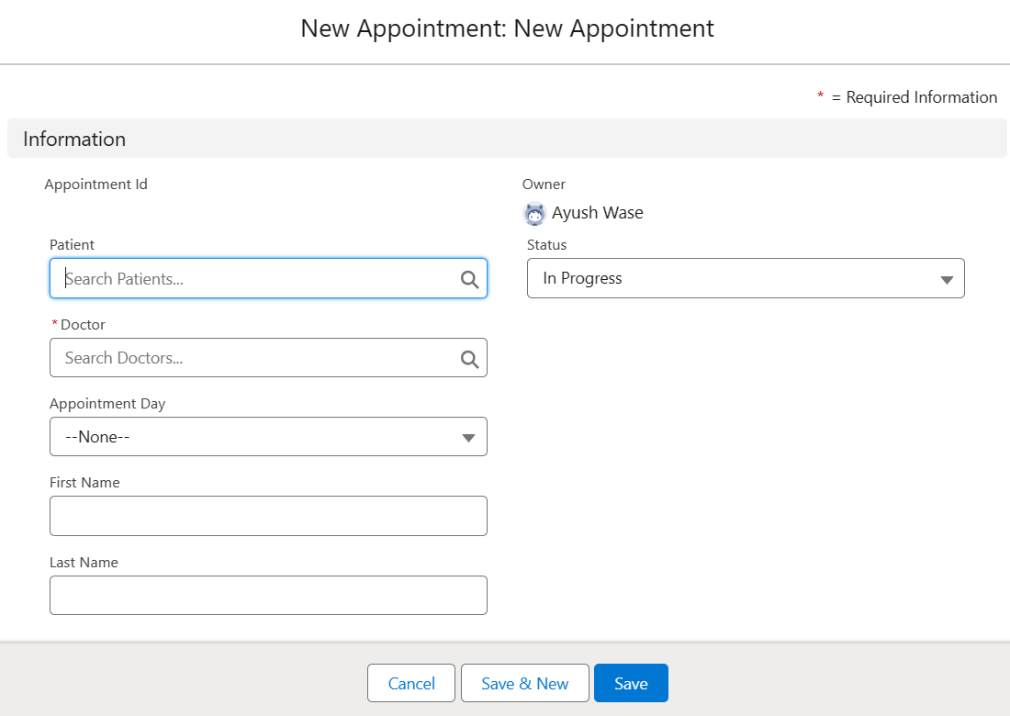
RESULTS
Figure 1. New Appointment Entry Page

Slide 11
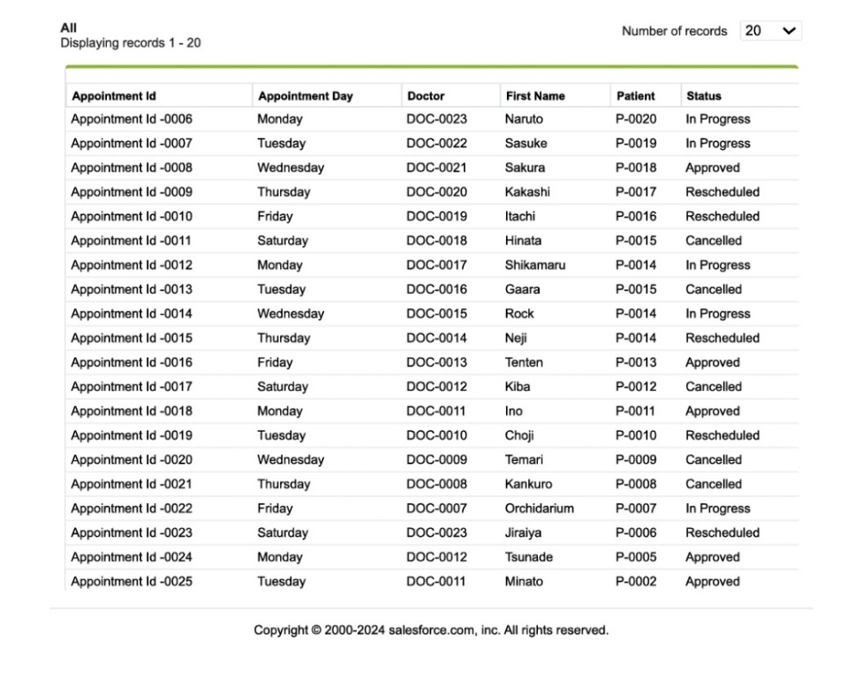
RESULTS
Figure 2. Appointment Record Page

Slide 12
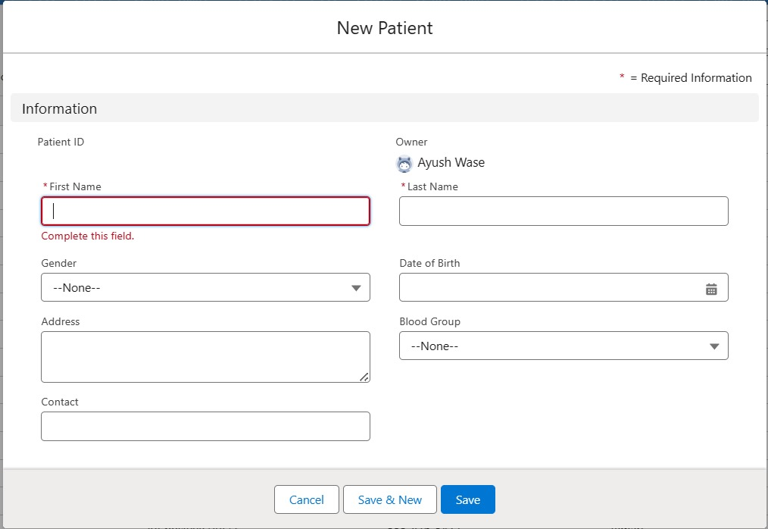
RESULTS
Figure 3. New Patient Entry Page

Slide 13
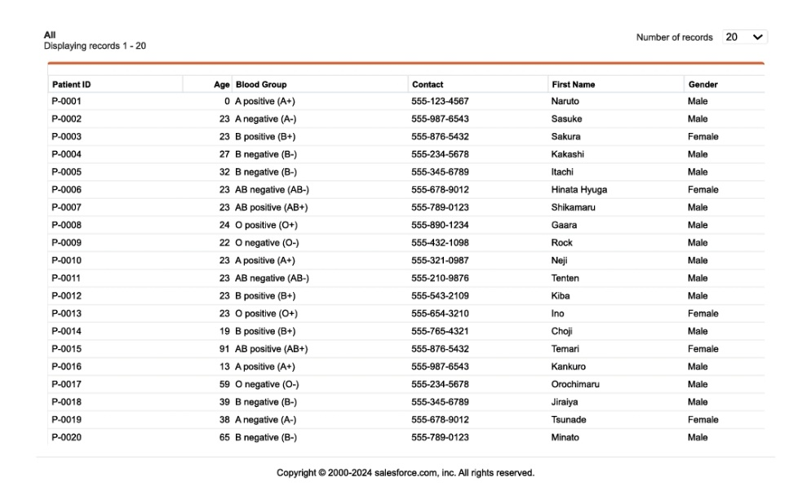
RESULTS
Figure 4. Patient Record Page

Slide 14
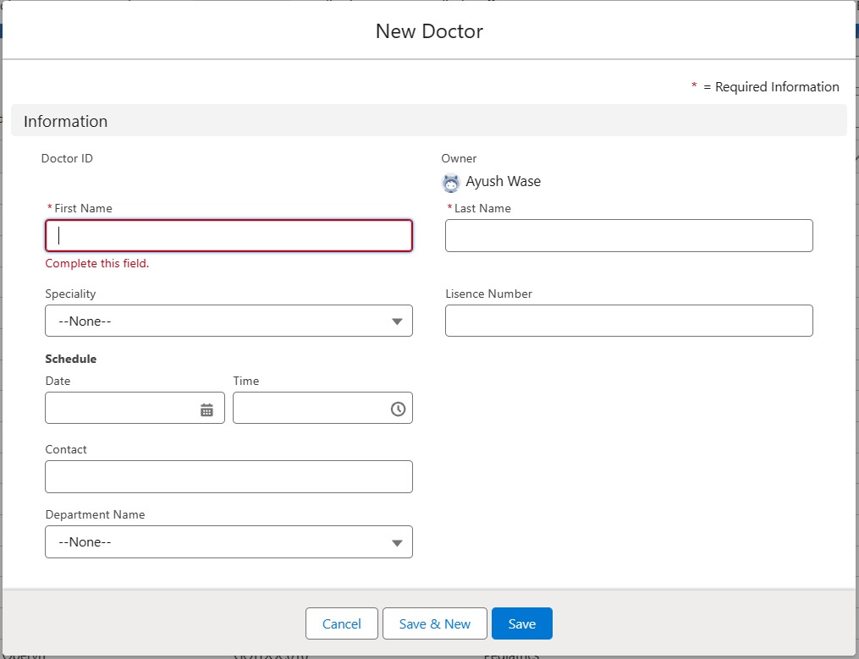
RESULTS
Figure 5. New Doctor Entry Page

Slide 15
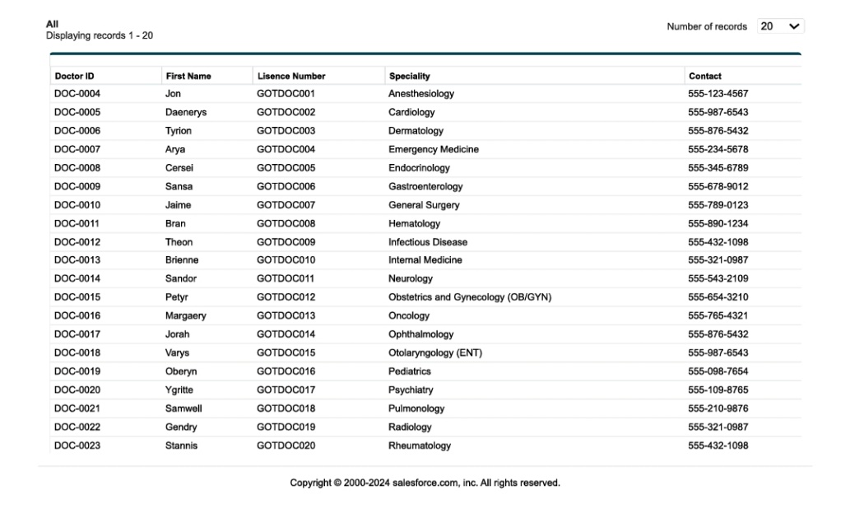
RESULTS
Figure 6. Doctors Record Page

Slide 16
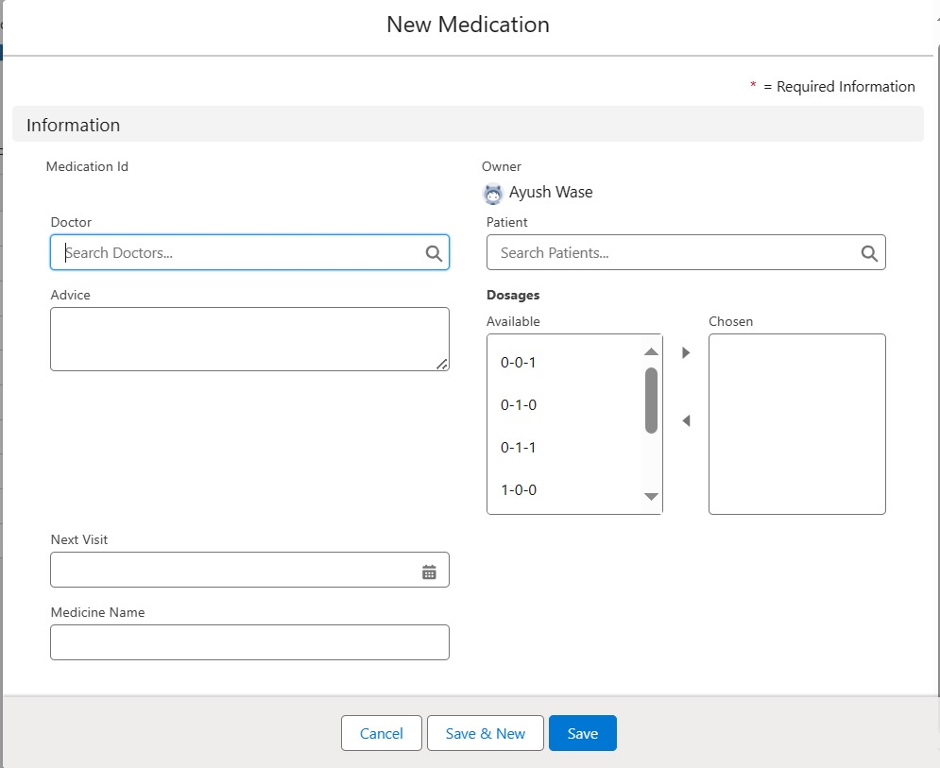
RESULTS
Figure 7. Medication Entry Page

Slide 17
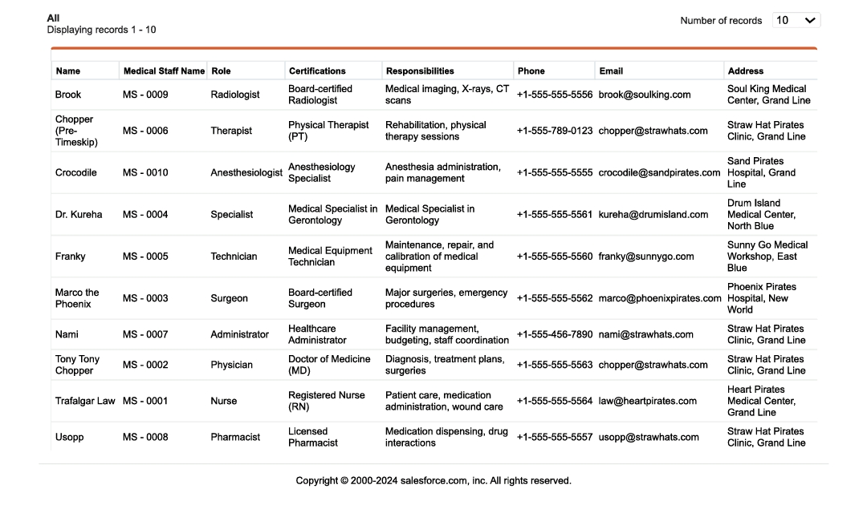
RESULTS
Figure 8. Medication Record Page

Slide 18
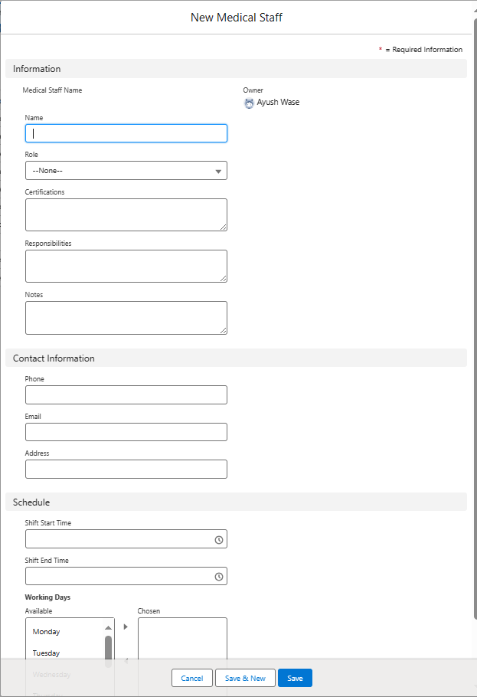
RESULTS
Figure 9. Medical Staff Entry Page

Slide 19
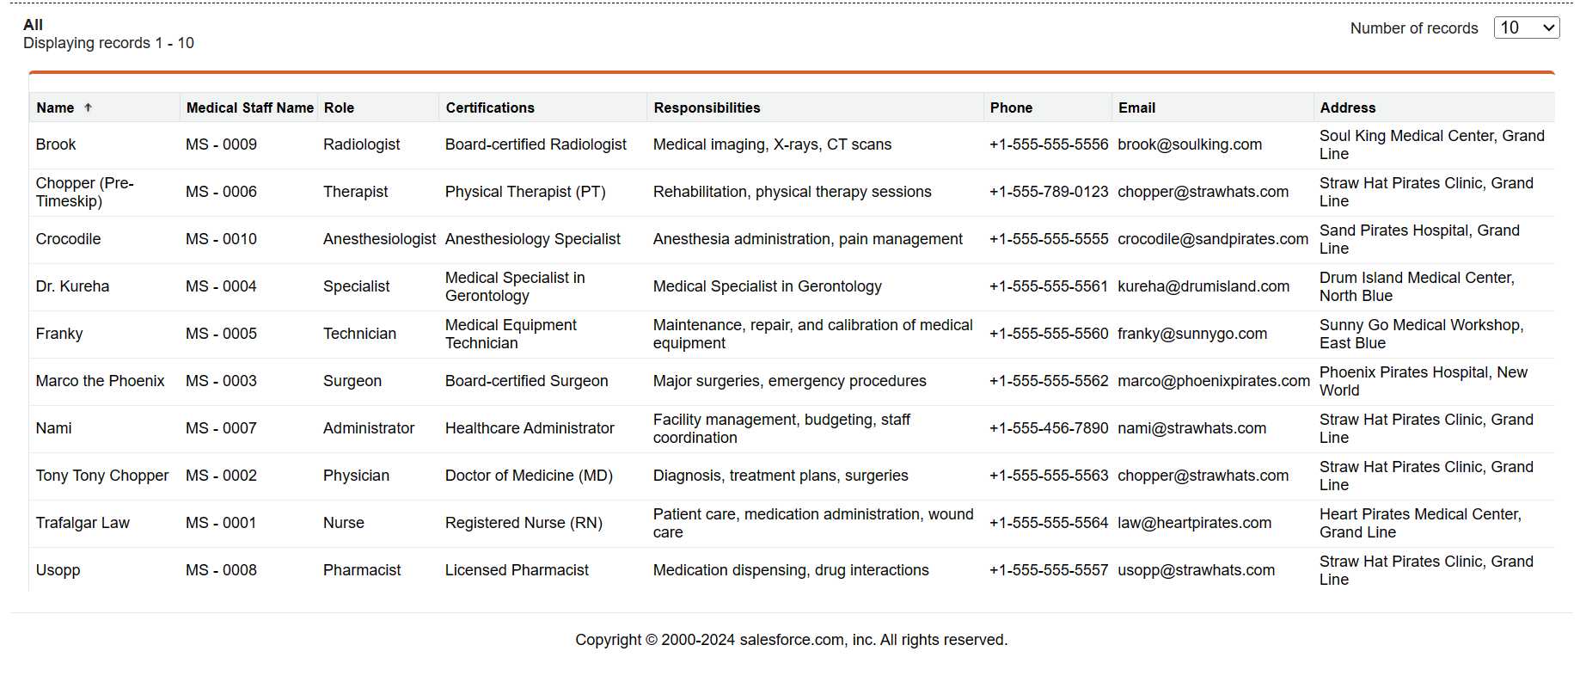
RESULTS
Figure 10. Medical Staff Record Page

Slide 20
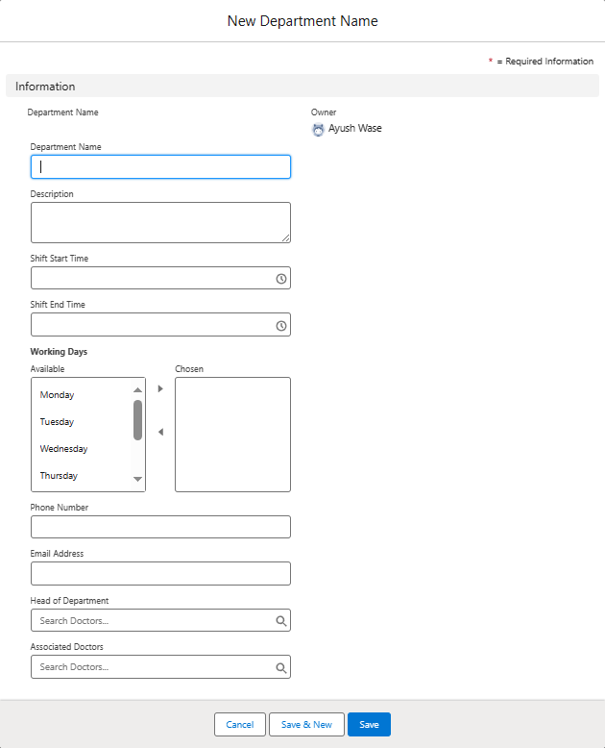
RESULTS
Figure 11. Department Entry Page

Slide 21
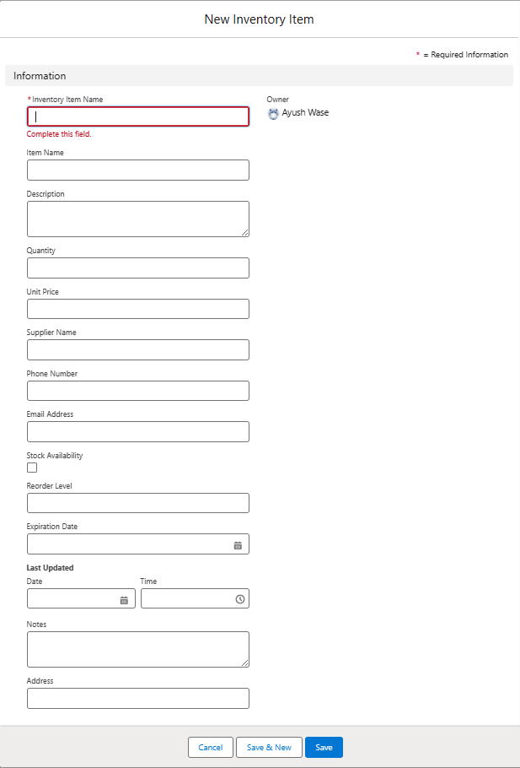
RESULTS
Figure 12. Inventory Item Entry Page

Slide 22
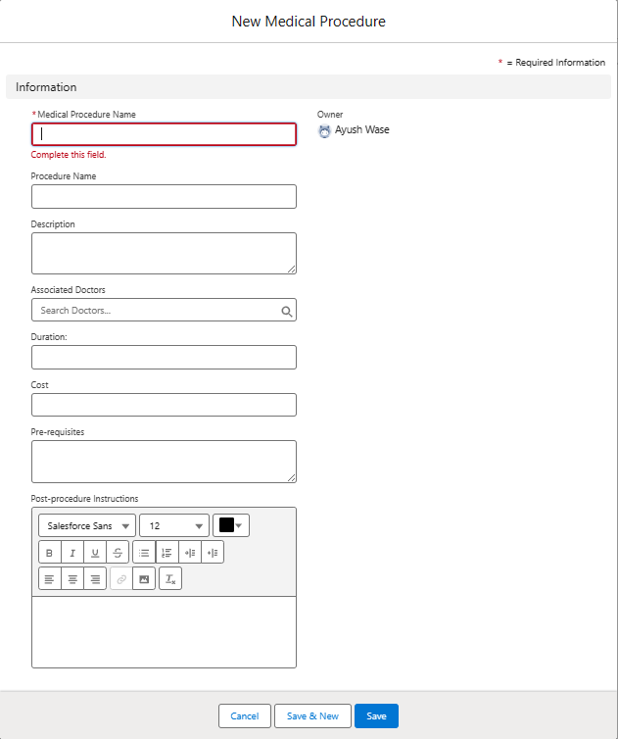
RESULTS
Figure 13. Medical Procedure Entry Page

Slide 23
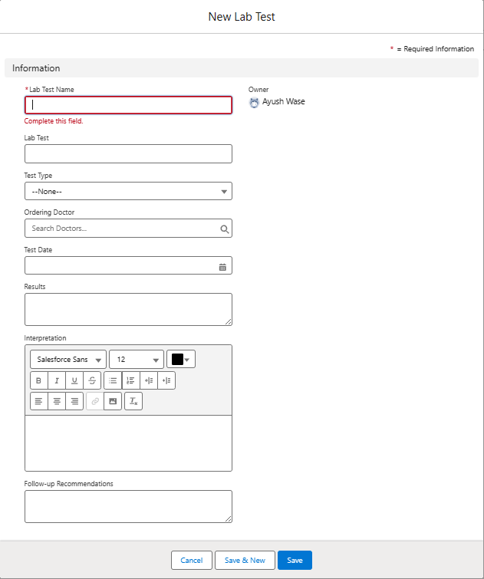
RESULTS
Figure 14. Lab Test Entry Page

Slide 24
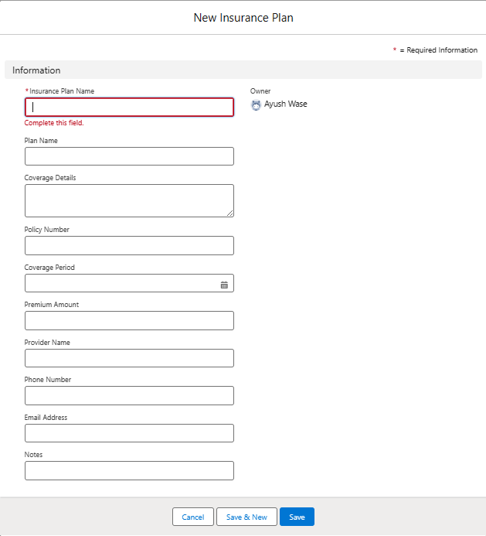
RESULTS
Figure 15. Insurance Plan Entry Page

Slide 25
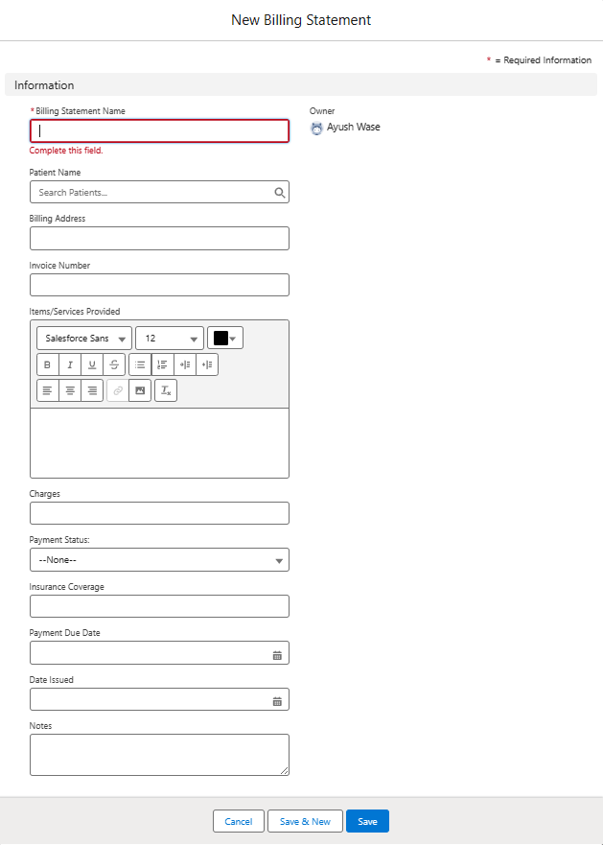
RESULTS
Figure 16. Billing Statement Entry Page

Slide 26
CONCLUSION
The implementation of our custom hospital management software, seamlessly integrated with the powerful Salesforce platform, has ushered in a transformative era for the healthcare organization. By establishing a centralized and comprehensive repository for patient data within Salesforce, we have created a unified and cohesive environment that enhances data accessibility, ensures consistency, and upholds high standards of accuracy across all medical-related information. The software's profound impact extends beyond mere data management. It has catalyzed a substantial optimization of operational efficiency, empowering healthcare providers to reallocate their valuable time and resources towards delivering exceptional patient care and enhancing medical operations. This paradigm shift has culminated in heightened patient satisfaction, as healthcare professionals can now respond promptly, provide superior medical services, and foster personalized interactions grounded in the comprehensive understanding facilitated by centralized patient data. As we reflect on the remarkable achievements of this endeavor, it becomes evident that the fusion of our expertise and Salesforce's robust capabilities has facilitated a paradigm shift in the healthcare industry. Organizations that embrace this transformative journey can unlock unprecedented opportunities to optimize operations, elevate patient experiences, and ultimately establish themselves as leaders in delivering world-class healthcare services that exceed expectations.

Slide 27
REFERENCES
[1] Garg, S. and Jindal, H., 2023. Operation Theater Allocation System using Salesforce CRM.Yu, J., 2019. Getting started with Salesforce Einstein analytics: A Beginner’s guide to building interactive dashboards. Apress.
[2] Lee, C.S., Tiong, A., Tang, W.L. and Yap, K.H., 2019, December. Data-Driven “Market Basket”-Pricing and Personalized Health Information Services Using Salesforce's Model-Driven Systems Service Design. In 2019 IEEE International Conference on Industrial Engineering and Engineering Management (IEEM) (pp. 576-580). IEEE.
[3] Sahlabadi, M., Muniyandi, R.C., Doroudian, N. and Usman, O.L., 2022, February. Impact of Cloud-Based Customer Relationship Management (CRM) in Healthcare Sector. In 2022 International Conference on Business Analytics for Technology and Security (ICBATS) (pp. 1-7). IEEE.Poniszewska-Maranda, A., Matusiak, R., Kryvinska, N. and Yasar, A.U.H., 2020. A real- time service system in the cloud. Journal of Ambient Intelligence and Humanized Computing, 11(3), pp.961-977.
[4] Ștefan, A.M., Rusu, N.R., Ovreiu, E. and Ciuc, M., 2024. Advancements in Healthcare: Development of a Comprehensive Medical Information System with Automated Classification for Ocular and Skin Pathologies—Structure, Functionalities, and Innovative Development Methods. Applied System Innovation, 7(2), p.28.Weinmeister, P. and Weinmeister, P., 2019. Optimizing Your UI Using Classic or Lightning. Practical Salesforce Development Without Code: Building Declarative Solutions on the Salesforce Platform, pp.375-402.

Slide 28
REFERENCES
[5] Zafar, A., 2021. Salesforce Data Architecture and Management: A pragmatic guide for aspiring Salesforce architects and developers to manage, govern, and secure their data effectively. Packt Publishing Ltd.Weinmeister, P. and Weinmeister, P., 2019. Create Efficient User Experiences with Actions. Practical Salesforce Development Without Code: Building Declarative Solutions on the Salesforce Platform, pp.331-360.
[6] Steffen, B., Braun von Reinersdorff, A. and Rasche, C., 2023. IT-Based Decision Support for Holistic Healthcare Management in Times of VUCA, Disorder, and Disruption. Applied Sciences, 13(10), p.6008.Sai Shah, Sandesh Tonde, Vijay Vhanale, “Recruiting App - A Custom App development in Cloud”, International Journal of Multidisciplinary Research and Development 2015; 2(1): 41-44.\
[7] REITER, T.S., 2022. IMPLEMENTATION OF BUSINESS INTELLIGENCE IN AN ELECTRONIC HEALTH RECORD TO IMPROVE HEALTHCARE MANAGEMENT (Doctoral dissertation, University of Applied Sciences).
[8] Younes, K., 2024. Salespeople's psychological antecedents of sales force automation adoption and use in the industrial healthcare setting. International Journal of Electronic Marketing and Retailing, 15(2), pp.203-222.Shaalan, S., 2020. Salesforce for Beginners: A step-by-step guide to creating, managing, and automating sales and marketing processes. Packt Publishing Ltd.

Slide 29
REFERENCES
[9] Varga, P. and Motz, L., 2023, March. How Canada can unlock health system capacity with technology: The value of long-term, value-based partnerships with technology providers. In Healthcare Management Forum (Vol. 36, No. 2, pp. 68-71). Sage CA: Los Angeles, CA: SAGE Publications.
[10] Kaliuta, K., 2024. Economic Benefits of Using Salesforce in Business: Analysis and Practical Recommendations. Futurity Economics&Law, 4(2), pp.83-99.
[11] Ahmad, B., Liu, D., Irfan, M. and Álvarez-García, J., 2022. Unleashing the mechanism among salesforce control system, salesforce ambidexterity, and emotional exhaustion to enhance the competitive advantage of organizations. Frontiers in Psychology, 13, p.909656.
[12] Rai, A.K. and Middula, V., 2023. Billing Worklog Using Salesforce.
[13] Zoltners, A.A., Sinha, P., Sahay, D., Shastri, A. and Lorimer, S.E., 2021. Practical insights for sales force digitalization success. Journal of Personal Selling & Sales Management, 41(2), pp.87-102.
[14] Sousa, M.J., Pesqueira, A.M., Lemos, C., Sousa, M. and Rocha, Á., 2019. Decision-making based on big data analytics for people management in healthcare organizations. Journal of medical systems, 43, pp.1-10.
[15] Mekawie, N. and Yehia, K., 2021. Challenges of deploying cloud computing in eHealth. Procedia Computer Science, 181, pp.1049-1057.

Slide 30

Thank You!

